Slide 1
Process controll –Hyperdrive Project
Joachim Raffaele Bono Elise Høimyr Séverine Oppliger
Group D

Slide 2
Demo
TODO: insert a video in case it doesn’t work

Slide 3

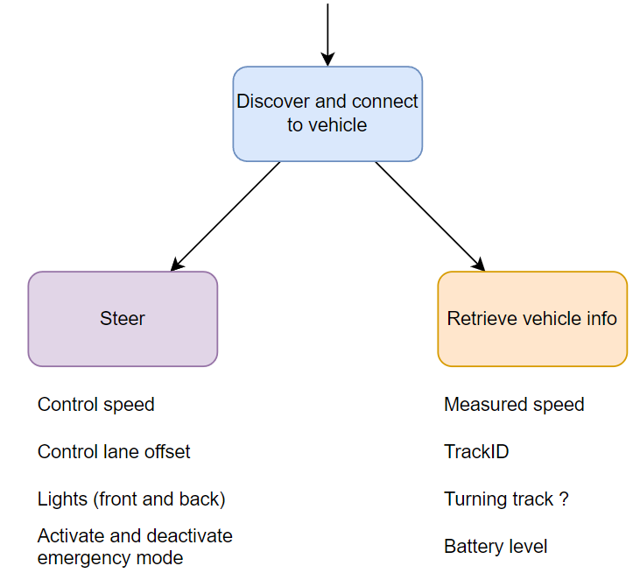

Java Implementation (1/2)
SUBSCRIPTIONS
PUBLICATIONS
Host discovering status
Host vehicles status
Target vehicle status
If false, send discover intent : true
2 threads

Slide 4















Java Implementation (2/2)
MVC design pattern
Thread
Steer
Wished speed
Wished lane offset
Front lights / Back lights
Emergency status
On
Off
MQTT
Emergency
Observable
Observer
Model
Controller
View
Measured speed
Turning status
Current track id
Battery level
Retrieve vehicle info
MQTT
Observable
Observer

Slide 5
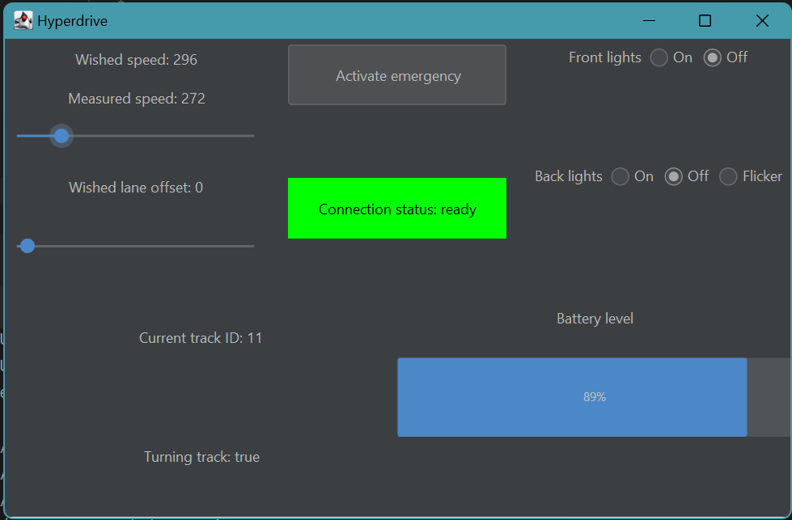

GUI
Python (uses Tkinter)
Java (uses Swing)

Slide 6
Difficulties
GUI:
Sliders: action (publish) at each step while we move it (not only when mouse realised)
→ fixed on Java but seems impossible on Python
Battery status: is not really reliable (shows 80 when battery is fast empty)
Concurrent programming: no Java interaction with MQTT emergency topic
→ no external emergency activation detected

